Slide 1
“Quiz” canciones
El indefinido

Slide 2
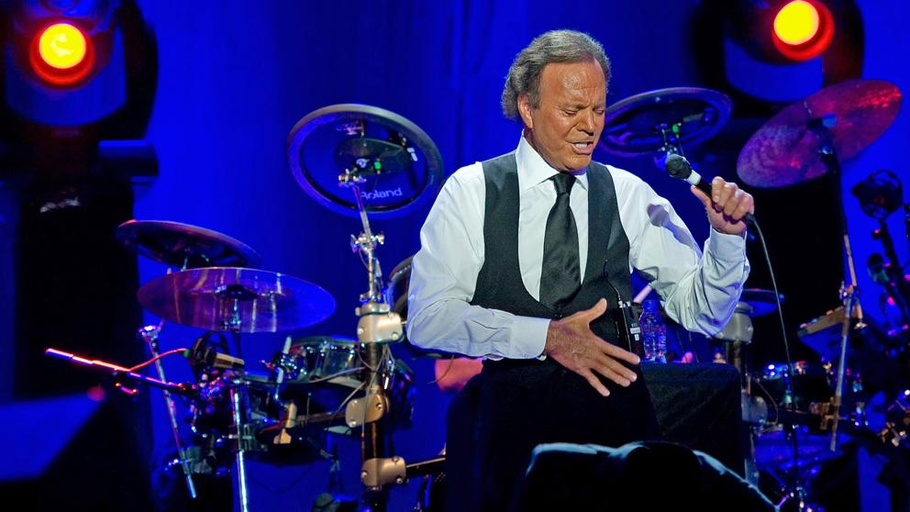
Julio Iglesias me olvidé de vivir
https://vibby.com/v/Xkwc19Gau

Slide 3
L. FONSI ft. Daddy yankee “despacito”
https://vibby.com/v/XJ36ZqG6_

Slide 4
Alvaro SOLER “LIBERTAD”
https://vibby.com/v/7JBLfcf6d

Slide 5
Alvaro SOLER – “Sofía”
https://vibby.com/v/m1eSX9MT_

Slide 6
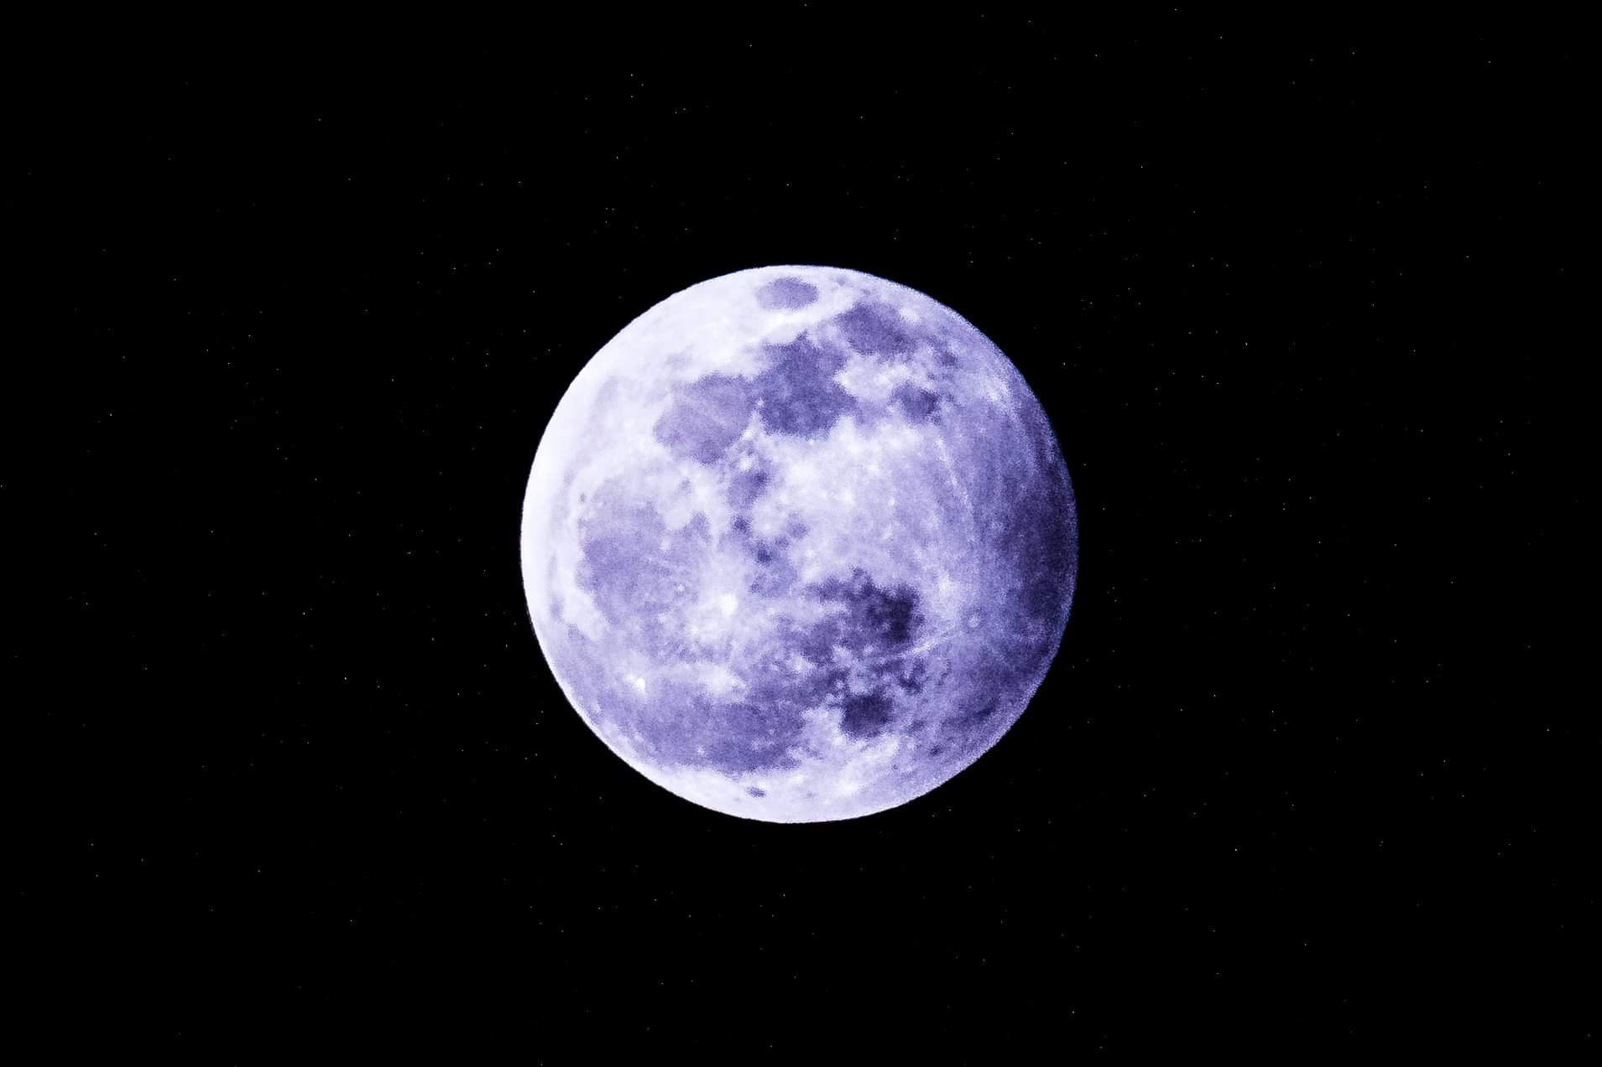
Mecano “hijo de la luna”
https://vibby.com/v/Xk8g4qMa_

Slide 7
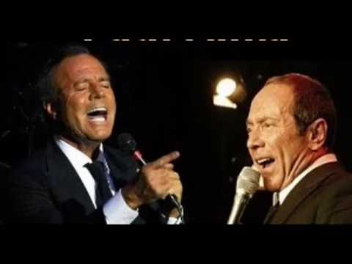
J. IGLESIAS- P. ANKA “a mi manera”
https://vibby.com/v/m1iI4qzT_

Slide 8
Pedro Capo – “Calma”
https://vibby.com/v/Q1IDB9MT_

Slide 9
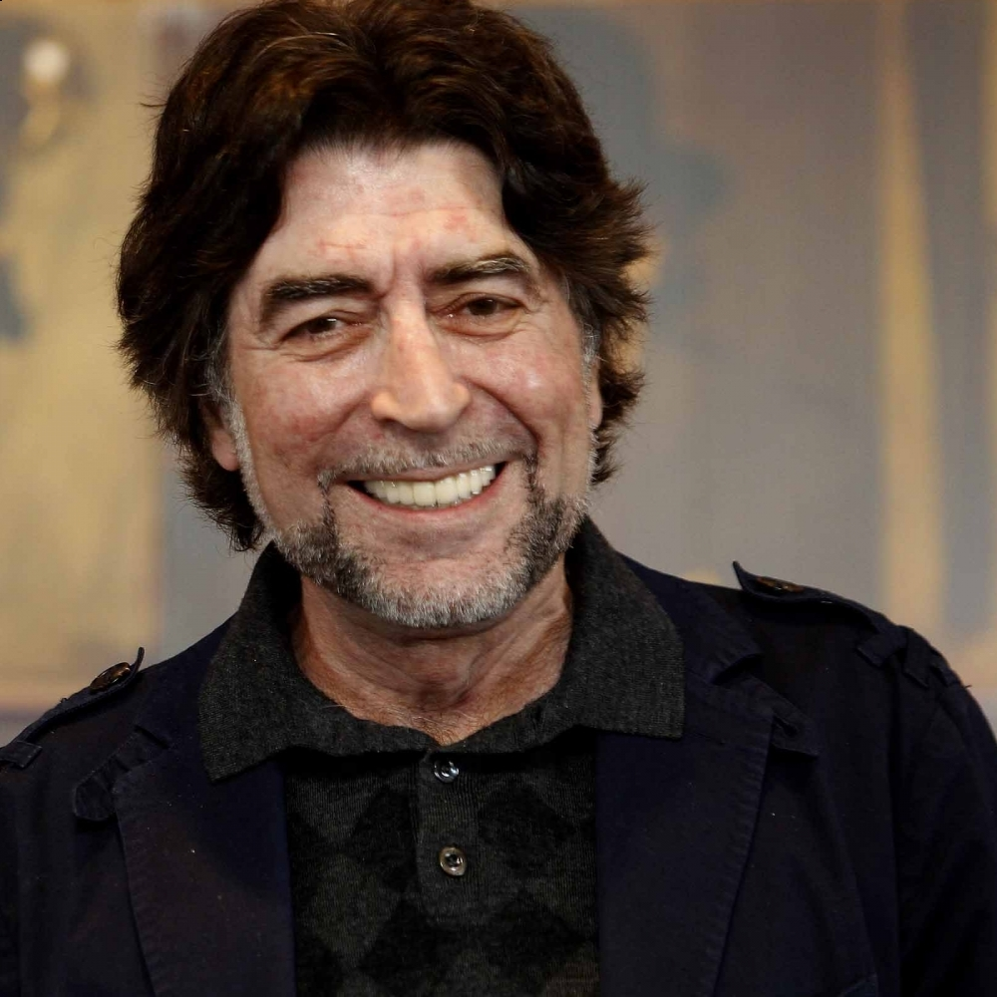
Joaqúin Sabina – “ataque de tos”
https://vibby.com/v/QyllZd9zpO

Slide 10
Nicky Jam – E. IGLESIAS “el perdón”
https://vibby.com/v/QkiFYqGp_

Slide 11
JUANES – La camisa negra
https://vibby.com/v/71m8qMLTu
https://vib.by/v/Qk4kEsMpO

Slide 12
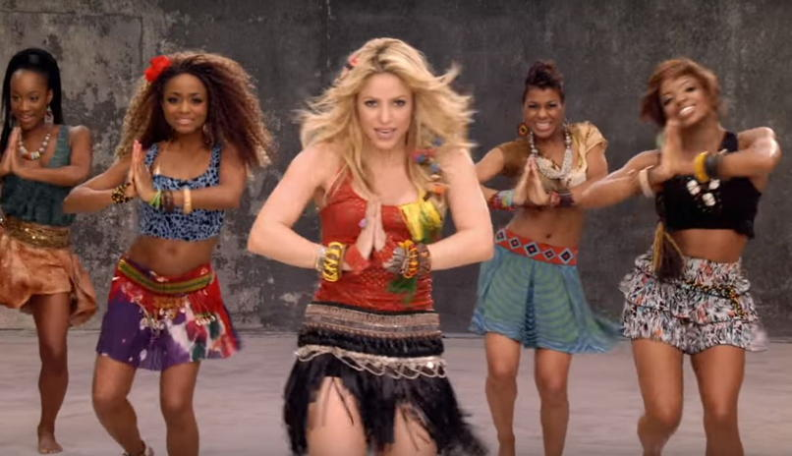
Shakira – “waka waka”
https://vibby.com/v/710NRqf6d

